Slide 1
Entitlement to Continuation Pay (CP)
TC
6

Slide 2

Agenda
Basic Finance
Consumer Protections
Planning for the Future
Saving and Investing
Summary and Resources
Entitlement to Continuation Pay Member Checklist Available

Slide 3

Basic Finance
Entitlement to Continuation Pay Member Checklist Available

Slide 4
Spending Plan
STEP 1 — Understand your current situation
  Track inflows and outflows
  Review past financial statements
STEP 2 — Know where your money should go
  Save and/or invest 10% – 15%*
  Transportation less than 15% – 20%*
  Limit housing to BAH or 25% – 30%
  or less*
STEP 3 — Create a plan
  Prioritize your financial goals
  Plan for new or different expenses
  Build an emergency fund
STEP 4 — Make adjustments
  Update with life changes
  Review frequently
STEP 1:
Understand your current
situation
STEP 4:
Make
adjustments
STEP 2:
Know where
your money
should go
4-STEP BUDGETING
PROCESS
  * Pretax income
STEP 3:
Create a plan
Spending Plan Worksheet Handout Available

Slide 5
Tax Fundamentals
Types of taxes
  Federal
  FICA
  State income taxes
Tax benefits for Service members
  BAH, BAS, and CZTE
  TSP and potential tax savings
Potential changes to your tax situation
  Review and adjust withholding on Direct Access
  IRS Tax Withholding Estimator

Slide 6
Tax Implications of Continuation Pay
Earned income
  Taxed at federal, state, and local levels
Tax planning
  Impact of one lump sum, two, three, or four installments
  Set aside funds to cover potential taxes
Combat Zone Tax Exclusion
  Review IRS Publication 3, The Armed Forces Tax Guide

Slide 7
Consumer Protections
Entitlement to Continuation Pay Member Checklist Available

Slide 8
Military Consumer Protections
Know your rights
Servicemembers Civil Relief Act (SCRA)
Military Lending Act (MLA)
Resources
  CG SUPRT
  https://www.consumerfinance.gov
  Local legal assistance office
Military Consumer Protection and Servicemembers Civil Relief Act
Handouts Available

Slide 9
Misleading Consumer Practices
Recognize scams
  Multilevel marketing / pyramid scheme
  Get rich quick
  Too good to be true
Protect yourself
  Research
  Comparison shop
  Sleep on it
Report a complaint
Sources of Help for Military Consumers Handout Available

Slide 10
Planning for the Future
Entitlement to Continuation Pay Member Checklist Available

Slide 11
The Four Components of BRS
Defined contribution
  Thrift Savings Plan with Coast Guard automatic and matching contributions
Continuation Pay
  Mid-career payout
Defined benefit
  Eligible for a pension after 20 years of service
Lump-sum option
  Choice on how to receive your pension at retirement
Military Retirement Handout Available

Slide 12
Continuation Pay Basics
One-time, mid-career payout
Paid in exchange for four years of additional service
Election is NOT automatic
In addition to other career incentives
and bonuses
A retention tool
Military Retirement and Continuation Pay Handouts Available

Slide 13
Continuation Pay Basics, Continued
Active Duty or Active Reserve
BRS participants only
Based on pay entry base date (PEBD)
Payable between 8 and 12 years of service*
Agree to four years of additional service
Must elect 30 days before CP date*
  Election timing is subject to change
*see latest ALCOAST

Slide 14
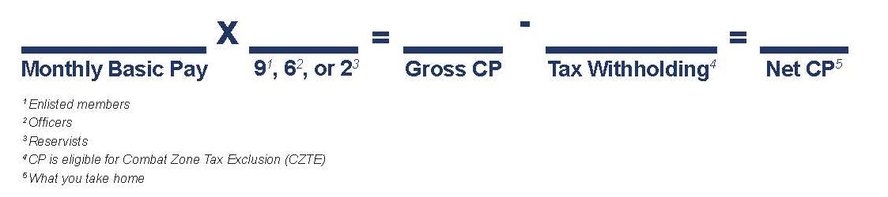
How is CP Calculated?
CP rates
  Active Duty –
    Enlisted 9* times basic monthly pay
    Officer 6* times basic monthly pay
  Reserve –
    2* times basic monthly pay
*Subject to change
Continuation Pay Handout Available

Slide 15
How is CP Disbursed?
You can choose to receive a one-time, lump-sum payment or spread your payments to potentially save on taxes.
One Lump-Sum Installment First installment is paid at the initial CP date and paid out 100% (less taxes).
Two Equal Installments First installment is paid at the initial CP date, and the next installment is paid the following year on the anniversary of the initial payment (less taxes).
Three Equal Installments First installment is paid at the initial CP date, and the remaining two payments are paid in equal annual installments at the anniversary of the initial payment (less taxes).
Four Equal Installments First installment is paid at the initial CP date, and the remaining three payments are paid in equal annual installments at the anniversary of the initial payment (less taxes).
Pick your installment plan
Remember, CP
is subject to tax withholding!
Your payment choice may affect taxes owed.
Review the IRS Tax Withholding Estimator.

Slide 16
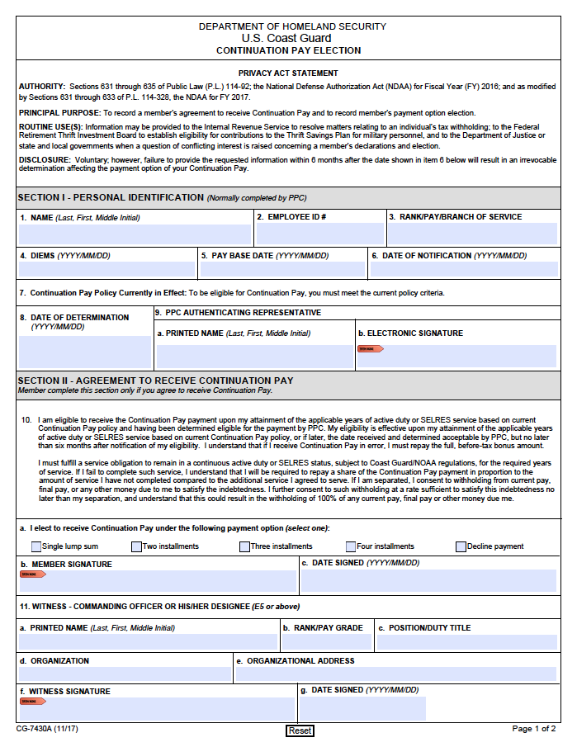
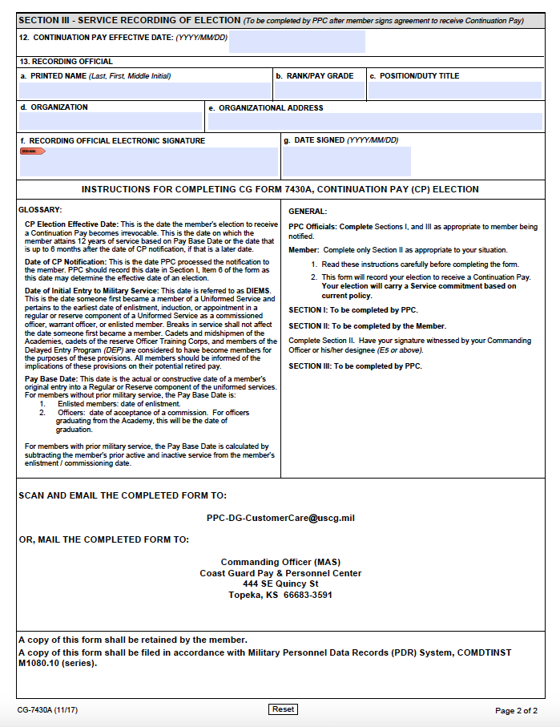
How to Apply for Continuation Pay –USCG
Complete CG Form 7430A with your Command & Pay Personnel Command (PPC) representatives
Email or mail completed form to PPC

Slide 17
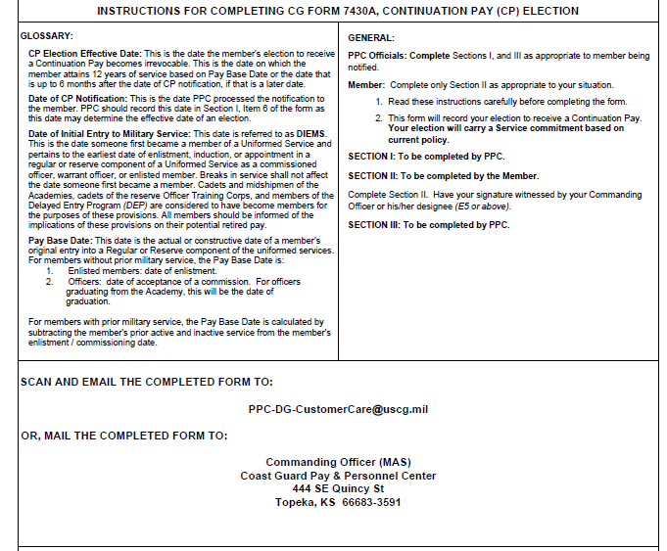
Instructions for Completing CG – 7430A
PPC Officials: Complete Sections I
and III as appropriate to member
being notified
Member: Complete only Section II
as appropriate to your situation
  Read the instructions carefully before completing the form.
  Have your signature witnessed by your commanding officer or his/her designee
  (E5 or above).
  This form will record your election to receive Continuation Pay. Your election will carry a Service Commitment based on your current policy.
Form can be located at media.defense.gov/2017/Dec/21/2001860344/-1/1/0/CG_7430A.PDF
Continuation Pay election obligates the Member to at least 4 additional years of service.
1
2

Slide 18
Financial Implications and Options
Failing to meet service obligations will require a repayment of a prorated amount.
What to do with your Continuation Pay
  Pay down debt
  Save for emergencies
  Invest for the future
  Make a major purchase
  Gift it
  Contribute to TSP

Slide 19
Saving and Investing
Entitlement to Continuation Pay Member Checklist Available

Slide 20
Evaluate Goals
Save 10% – 15% of pretax pay
Emergency fund
Invest for the long term
  Be patient
Dollar cost averaging
  Invest regular basis
  Invest continuously
TSP considerations
  Contributions from CP are not eligible for matching
  Elective deferral limit for 2025 – $23,500
  Annual additions limit for 2025 – $70,000 (CZTE)
  Plan contributions from basic pay to receive matching contributions
Goal-Setting Worksheet and Basic Investing Handouts Available

Slide 21
Summary and Resources
Entitlement to Continuation Pay Member Checklist Available

Slide 22
Summary
Congratulations on reaching this important milestone!
Let’s recap what you learned to help in decision making as you approach eligibility for Continuation Pay:
  Basic Finance
  Consumer Protections
  Planning for the Future
  Saving and Investing

Slide 23
Resources
Checklist and Handouts
Financial Education and Support
  Command Financial Specialists (CFSs)
  Personal Financial Managers (PFMs)
  Health, Safety and Work-Life (HSWL) Regional Practice
  Coast Guard Mutual Assistance (CGMA)
  CG SUPRT
Financial Literacy Mobile Apps
  Coast Guard Work-Life mobile app
  DoD FINRED Sen$e mobile app

Slide 24
Thank You!
The appearance of U.S. Department of Homeland Security (DHS)
visual information does not imply or constitute DHS endorsement.

